Slide 1
Lexical Analysis

Slide 2
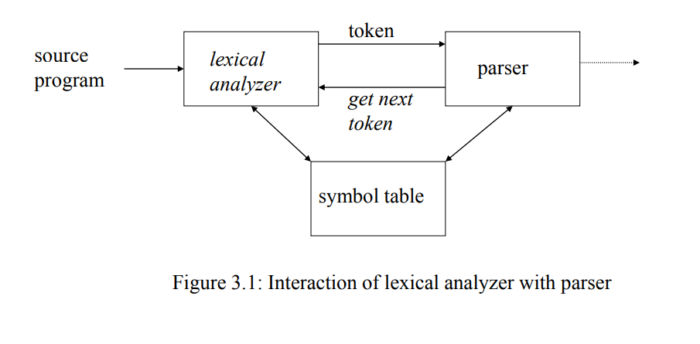
The Role of the Lexical Analyzer

Slide 3
Lexical Analyzer
First phase of a compiler
Main task
To read the input characters
To produce a sequence of tokens used by the parser for syntax analysis
As an assistant of parser
Interaction of lexical analyzer with parser
Processes in lexical analyzers
Scanning
Pre-processing
Strip out comments and white space
Macro functions
Correlating error messages from compiler with source program
A line number can be associated with an error message

Slide 4
Lexical analyzer are divided into a cascade of two phases:
Scanning consists of the simple processes that do not require tokenization of the input, such as deletion of comments and compaction of consecutive whitespace characters into one.
Lexical analysis proper is the more complex portion, where the scanner produces the sequence of tokens as output.

Slide 5
Why the analysis portion of a compiler is normally separated into lexical analysis and parsing (syntax analysis) phases?
Simplicity of design.
Compiler efficiency is improved
Compiler portability is enhanced.

Slide 6
Tokens, Patterns and Lexemes
Token:
A classification for a common set of strings or a group of characters having a collective meaning
Examples: Integer, Float, a particular keyword, or a sequence of input
characters denoting an identifier
Pattern:
A description of the form that the lexemes of a token may take
The rule describing how a token can be formed
Lexeme:
A lexeme is a sequence of characters in the source program that matches the
pattern for a token
Actual sequence of characters that matches pattern and is classified by a token
Identifiers: x, count, name, etc… Integers: 345, 20 -12, etc.

Slide 7
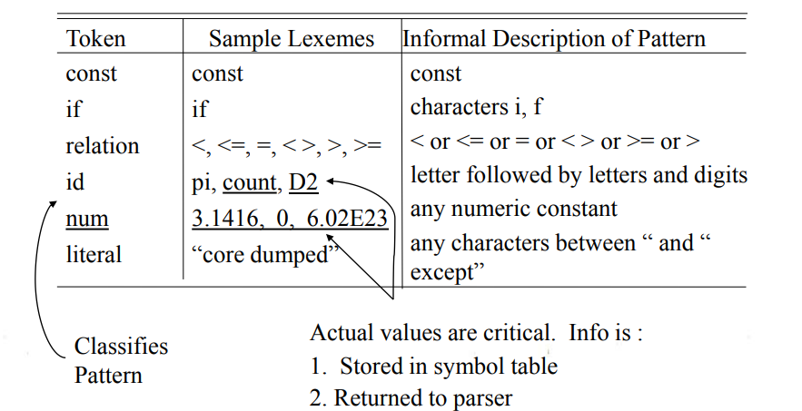
Example: C statement
printf( "Total = %d\n" , score ) ;
both printf and score are lexemes matching the pattern for token id, and "Total = %d\n" is a lexeme matching literal.

Slide 8
Lexical Errors:
Some errors are out of power of lexical analyzer to recognize: fi (a == f(x)) …
However it may be able to recognize errors like: d = 2r
Such errors are recognized when no pattern for tokens matches a character sequence
Error Handling is very localized, with Respect to Input Source
For example: while ( x := 0 ) do…, generates no lexical errors in PASCAL
Error recovery:
Deleting an extraneous character
Inserting a missing character
Replacing an incorrect character by a correct character
Transposing two adjacent characters(such as , fi→if)

Slide 9
Input Buffering
Sometimes lexical analyzer needs to look ahead some symbols to decide about the token to return
In C language: we need to look after -, = or < to decide what token to return
We need to introduce a two buffer scheme to handle large look-aheads safely
Two-buffer input scheme to look ahead on the input and identify tokens
Buffer pairs
Because of the amount of time taken to process characters and the large number of characters that must be processed during the compilation of a large source program, specialized buffering techniques have been developed to reduce the amount of overhead required to process a single input character.

Slide 10
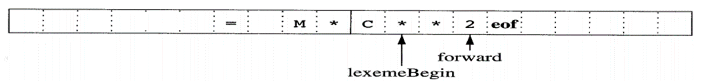
Two pointers to the input are maintained: Pointer lexemeBegin: marks the beginning of the current lexeme, Pointer forward: scans ahead until a pattern match is found.
Fig: Using a pair of input buffers

Slide 11
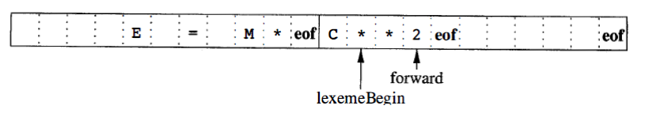
Sentinels(Guards)
For each character read, we make two tests: one for the end of the buffer, and one to determine what character is read.
The sentinel is a special character that cannot be part of the source program, and a natural choice is the character eof.
Note that eof retains its use as a marker for the end of the entire input.
Any eof that appears other than at the end of a buffer means that the input is at an end.
Fig: Sentinels at the end of each buffer

Slide 12
Specification of Tokens
Alphabet or character:
Finite set of symbols
Example {0,1}, or {a,b,c}, or {n,m, … , z}
String:
Finite sequence of symbols from an alphabet.
Example 0011 or abbca or AABBC …
If S is a string, then |S| is the length of S, i.e. the number of symbols in the string S.
Ɛ : Empty String, with | Ɛ | = 0
Language:
A set of strings over an alphabet.

Slide 13
Language Concepts:
A language, L, is simply any set of strings over a fixed alphabet.
Alphabet Languages
{0,1} s {0,10,100,1000,100000…}
{a,b,c} {abc,aabbcc,aaabbbccc,…}
{A, … ,Z} {TEE,FORE,BALL,…}
{A,..,Z,a,..,z,0,..9, +,-,..,<,>,..} { All legal PASCAL progs}
{ All grammatically correct English sentences}

Slide 14
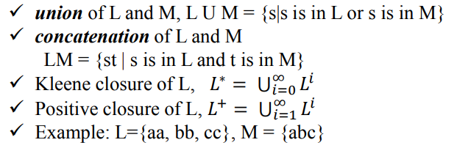
Operation on languages (a set):

Slide 15
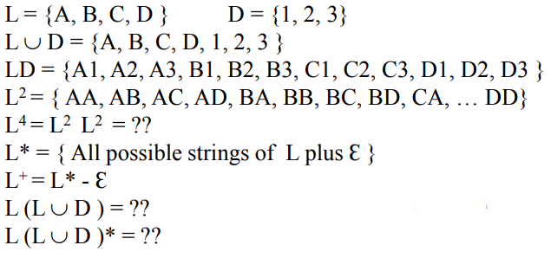
Example:

Slide 16
Prefix: removing zero or more trailing symbols of string - ban, banana
Suffix: deleting zero or more leading symbols of string - ana, banana
Substring: deleting prefix or suffix from string - nan, ban, ana, banana
Subsequence: deleting zero or more not necessarily contiguous symbols - bnan, nn
N.B.: Proper prefix, suffix, or substring cannot be all of S
Special Languages: Ø - EMPTY LANGUAGE
Ɛ - contains Ɛ string only

Slide 17
Regular Expression
A notation that allows us to define a pattern in a high level language.
a set of Rules / Techniques for constructing sequences of symbols (Strings) from an Alphabet.
The rule of regular expression over alphabet are,
Ɛ is a regular expression that denote {Ɛ}, the set that contains the empty string.
For each a ϵ Ʃ, a is a regular expression denote {a}, the set containing the string a.
r and s are regular expressions denoting language L(r) and L(s). Then
( r ) | ( s ) is a regular expression denoting L( r ) U L( s )
( r ) ( s ) is a regular expression denoting L( r ) L ( s )
( r )* is a regular expression denoting (L ( r )) *
(r) is a regular expression denting L(r)

Slide 18
Regular language:
Each regular expression r denotes a language L(r) (the set of sentences relating to the regular expression r)
Regular set:
A language denoted by a regular expression is said to be regular set.
Unnecessary pairs of parentheses can be avoided in regular expression if we adopt the conventions that :
a) The unary operator * has highest precedence and is left associative.
b) Concatenation has second highest precedence and is left associative.
c) | has lowest precedence and is left associative.

Slide 19
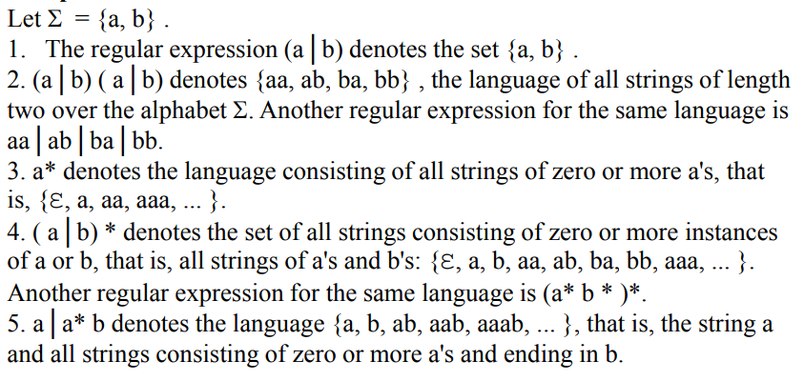
Example:

Slide 20
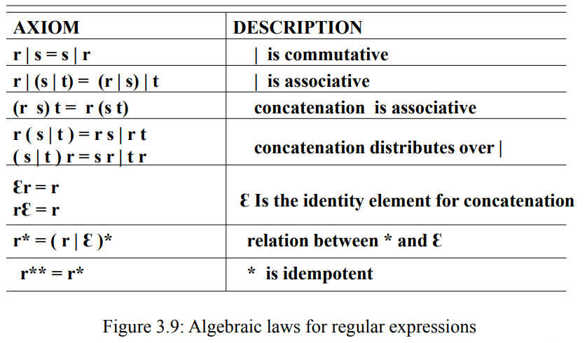

Slide 21
Regular Definition
gives names to regular expressions to construct more complicate regular expressions.
If Ʃ is an alphabet of basic symbols, then a regular definition is a sequence of definitions of the form:
𝑑₁ → 𝑟₁
𝑑₂ → 𝑟₂
…
𝑑_{𝑛} → 𝑟_{𝑛}
where:
1. Each 𝑑_{𝑖} is a new symbol, not in Ʃ and not the same as any other of the d's, and
2. Each 𝑟_{𝑖} is a regular expression over the alphabet Ʃ U {𝑑₁ , 𝑑₂ , . . .,d_{𝑖−1}}·

Slide 22
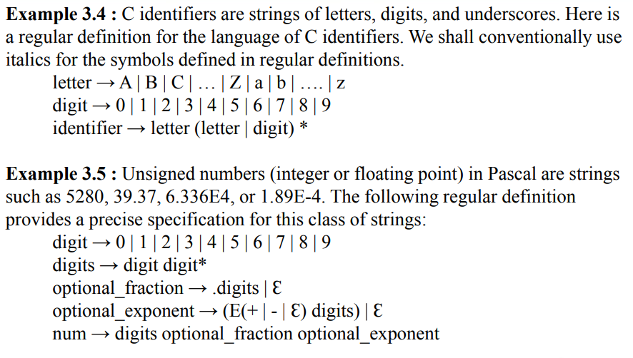

Slide 23
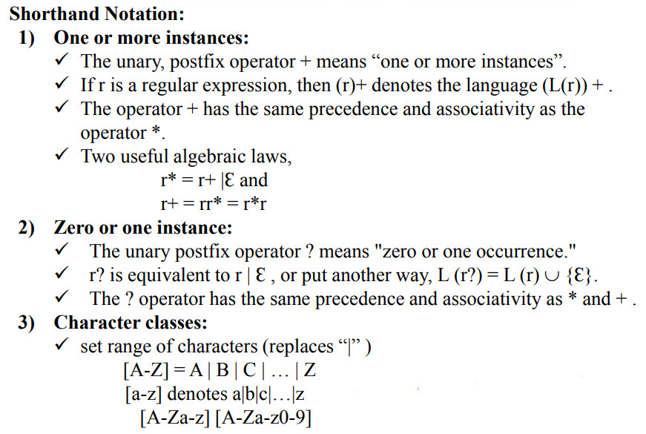

Slide 24
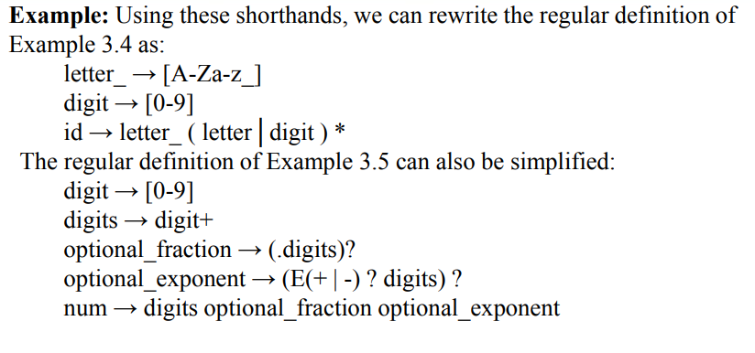

Slide 25
Transition Diagram
Depict the actions that take place when a lexical analyzer is called by the parser to get the next token.
Transition Diagrams (TD) are used to represent the tokens – these are automatons!
As characters are read, the relevant Transition Diagrams are used to attempt to match lexeme to a pattern
Each Transition Diagrams has:
States : Represented by Circles
Actions : Represented by Arrows between states
Start State : Beginning of a pattern (Arrowhead)
Final State(s) : End of pattern (Concentric Circles)
Each Transition Diagrams is Deterministic - No need to choose between 2 different actions !

Slide 26
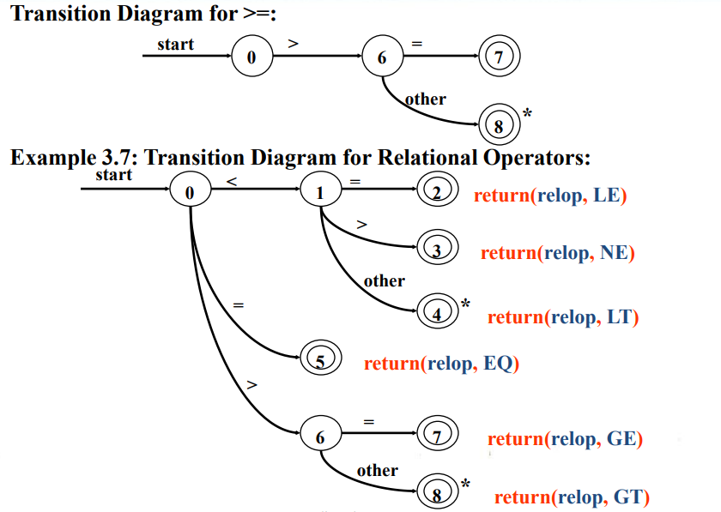

Slide 27
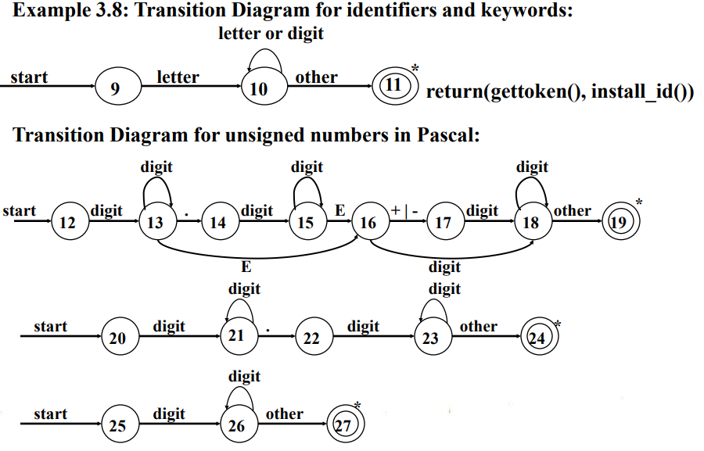

Slide 28
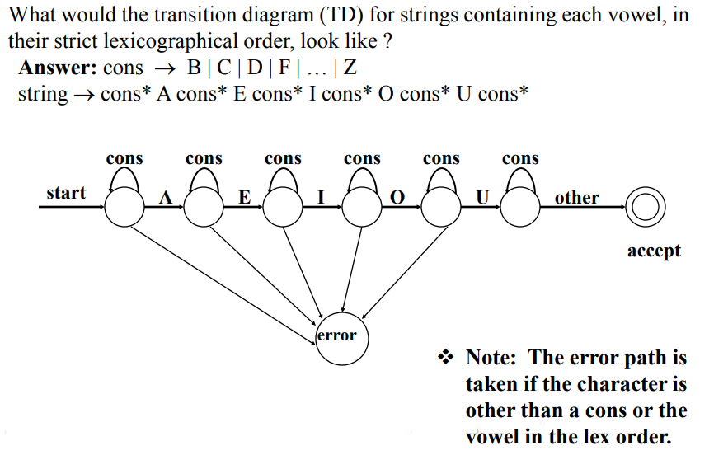

Slide 29
Finite Automata
Finite automata are recognizers; they simply say "yes" or "no" about each possible input string. OR
A recognizer that takes an input string and determines whether it’s a valid string of the language.
A generalized transition diagram.
Regular expressions is specification and Finite automata is implementation
A finite automaton consists of:
An input alphabet Ʃ
A set of states S
A start state n
A set of accepting states F is subset of S
A set of transitions state → input state

Slide 30
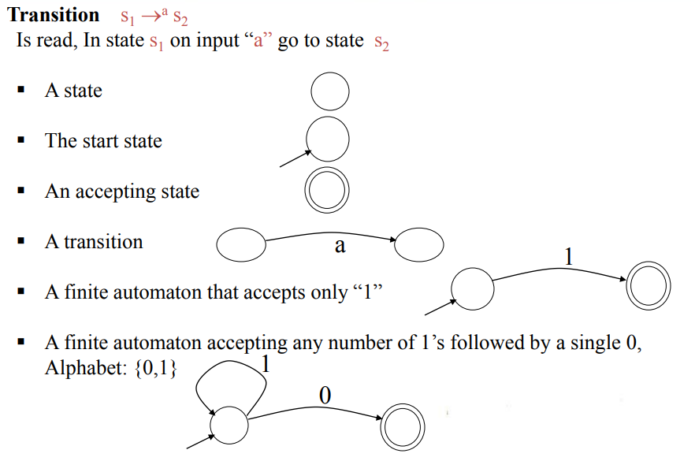

Slide 31
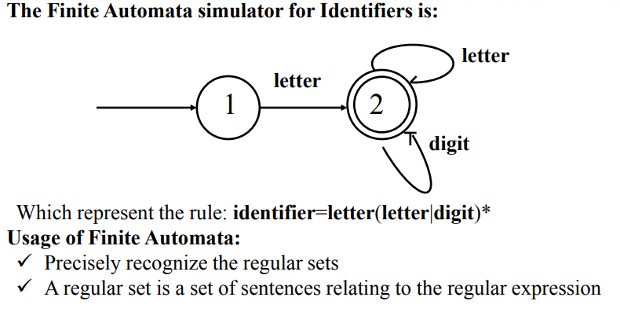

Slide 32
Finite automata come in two flavors:
Nondeterministic finite automata (NFA):
Have no restrictions on the labels of their edges.
Can have multiple transitions for one input in a given state
Can have Ɛ –moves
Non-Deterministic Finite Automata (NFAs) easily represent regular expression, but are somewhat less precise
Deterministic finite automata (DFA):
One transition per input per state
No Ɛ –moves
Completely determined by input
A DFA accepts an input string x if and only if there is some path in the transition graph from start state to some accepting state
Deterministic Finite Automata (DFAs) require more complexity to represent regular expressions, but offer more precision.

Slide 33
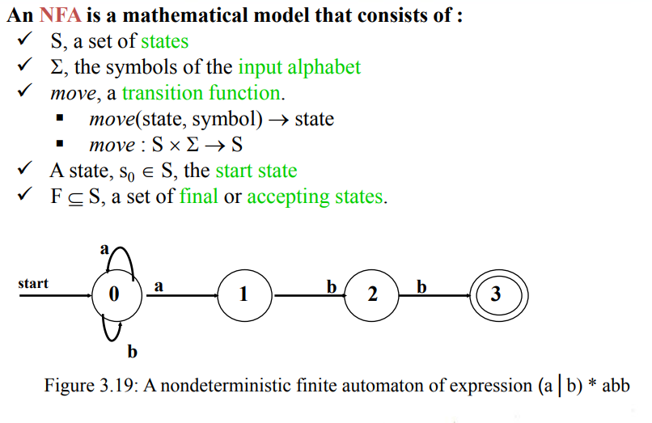

Slide 34
